Slide 1

DIGITAL MULTIMETER using Arduino nano
MINOR PROJECT
Rohan Bansal(41476802817)
Saksham Khatri (42076802817)
Yadnesh Revankar (43176802817)
ECE-03 (2017-2021)
MENTOR-
Mrs. Raman Dhand
(ECE Dept.)

Slide 2
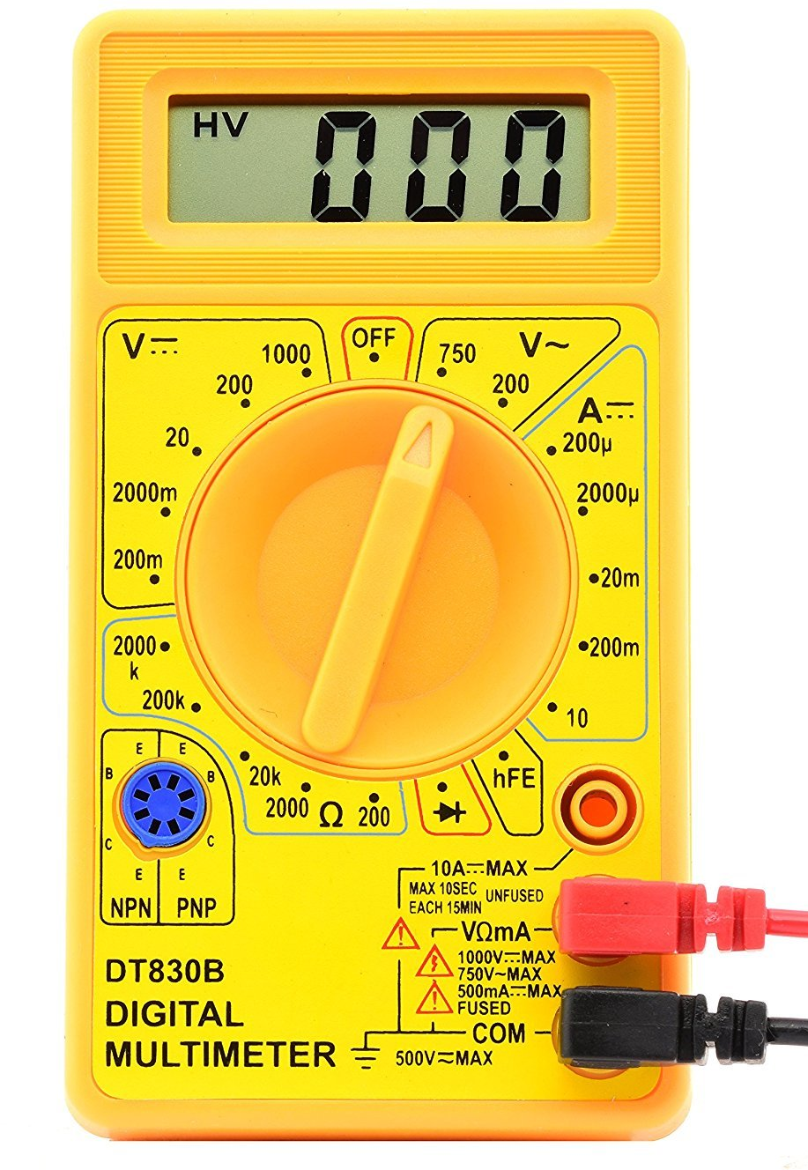
Introduction of multimeter
A multimeter or a multitester, also known as a VOM (volt-ohm-milliammeter), is an electronic measuring instrument that combines several measurement functions in one unit. A typical multimeter can measure voltage, current, and resistance. Analog multimeters use a microammeter with a moving pointer to display readings.

Slide 3
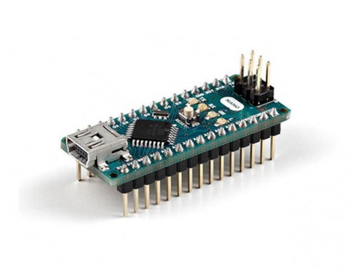
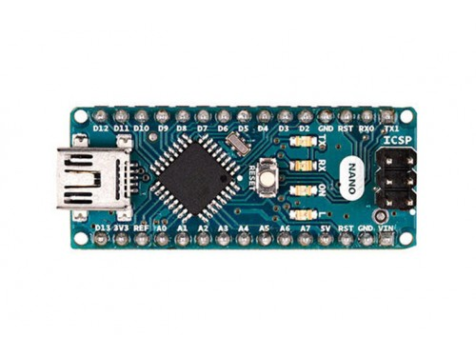
Introduction to Arduino
The Arduino Nano is a small, complete, and breadboard-friendly board based on the ATmega328 (Arduino Nano 3.x). It has more or less the same functionality of the Arduino Duemilanove, but in a different package. It lacks only a DC power jack, and works with a Mini-B USB cable instead of a standard one.

Slide 4
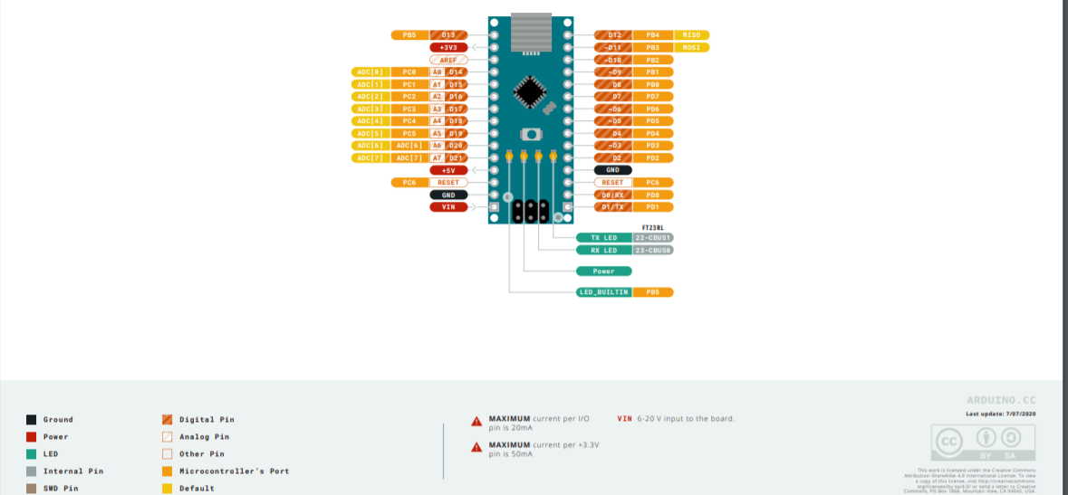
Pin diagram of Arduino nano

Slide 5
Components used
1 x Arduino NANO
1 x ADS1115 sensor
1 x i2c OLED screen
1 x TP4056 charging module
1 x ACS712 current sensor
1 x LM324 OPAMP
10 x female bullet connectors
2 x male bullet connectors
3 x push buttons
le bullet connectors
1 x sliding switch
1 x 3.7V li-po battery
RESISTORS: 1x150, 1x220, 1x330, 2x2K, 1x6.8K, 1x10K, 1x20K, 1x470k
2 x 1n4001 diode
2 x 1µF nonpolarized capacitor
wire, solder, soldering-iron, 3D case, etc

Slide 7
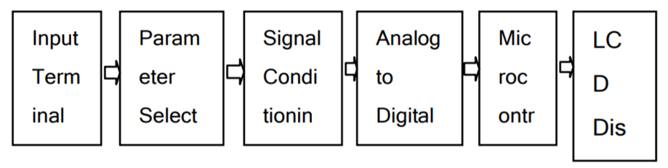
FUNCTIONAL DISCRIPTION
Proposed scheme of the Microcontroller based Digital Multi-meter is as shown in block diagram having following section.-

Slide 8
A. Parameter Selection Circuit:
This section is responsible for the selection of the desired parameter and let the micro-controller know about what action should be taken by microcontroller, as here different parameters are required to be measured one at a time.
B. Signal Conditioning Circuit:
The purpose of this circuit is to process different type of parameter so that they can be measured by microcontroller. This section have many different kind of circuit like amplifiers, attenuators, frequency multiplier, precision rectifier, RC oscillators etc. All these are required to convert our input parameter to a state which can be measured by microcontroller without any problem.
C. Microcontroller Arduino Nano:
Microcontroller is used to read different kind of parameter at its input through the selection circuit. The main operation of microcontroller is to read data from ADC or any other input as selected by selection circuit. The measured data of whole scheme is processed before displaying it on LCD in a user understandable format.
D. LCD/OLED Display:
The LCD display is used to display the selected operation and measured value of selected parameter at input terminal.
E. Power Supply:
Proposed scheme require a DC power supply for the operation of our system. This power supply can be made by using a rechargeable battery.

Slide 9
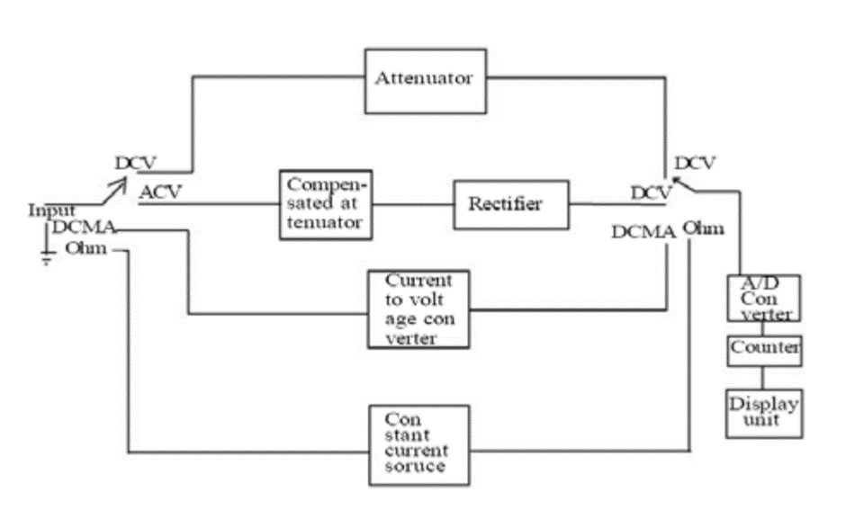
BLOCK DIAGRAM OF DIGITAL MULTIMETER:

Slide 10
Intro about software
Arduino IDE – version 1.8.13
The Arduino Integrated Development Environment is a cross-platform application that is written in functions from C and C++. It is used to write and upload programs to Arduino compatible boards, but also, with the help of third-party cores, other vendor development boards.
Some different libraries to be included are – ADS1x15 ADC module library
- GFX graphics core library
-OLED display library

Slide 11
PARAMATERS MEASURED BY MULTIMETER
Voltage
Resistance
Capacitance
Inductance
Current

Slide 12
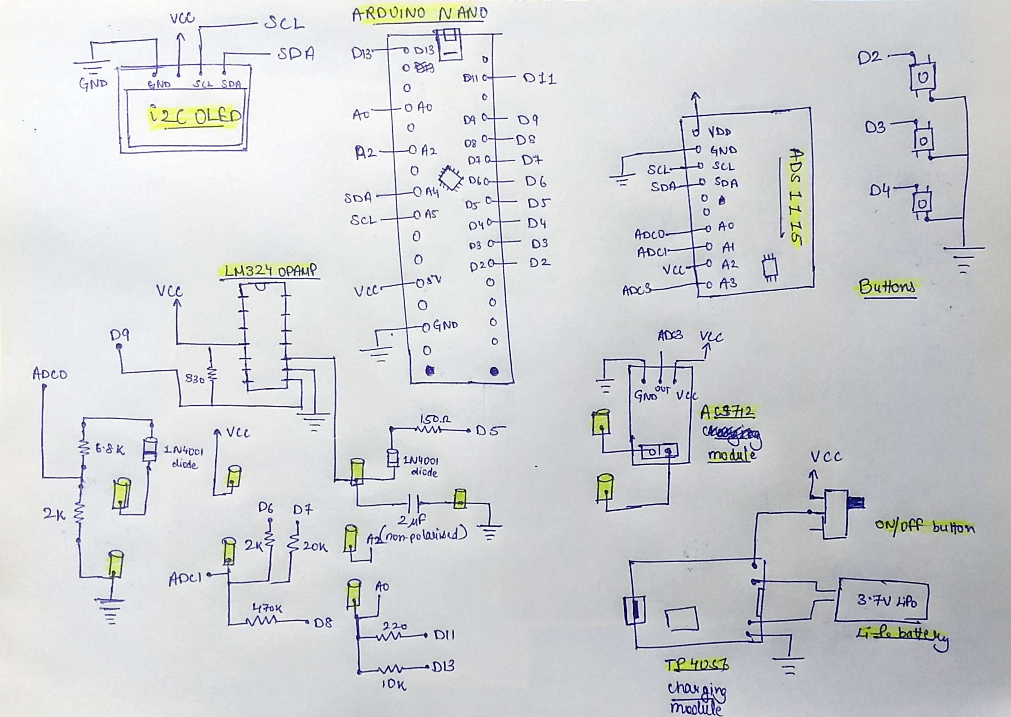
FINAL SCHEMATIC DIAGRAM

Slide 13
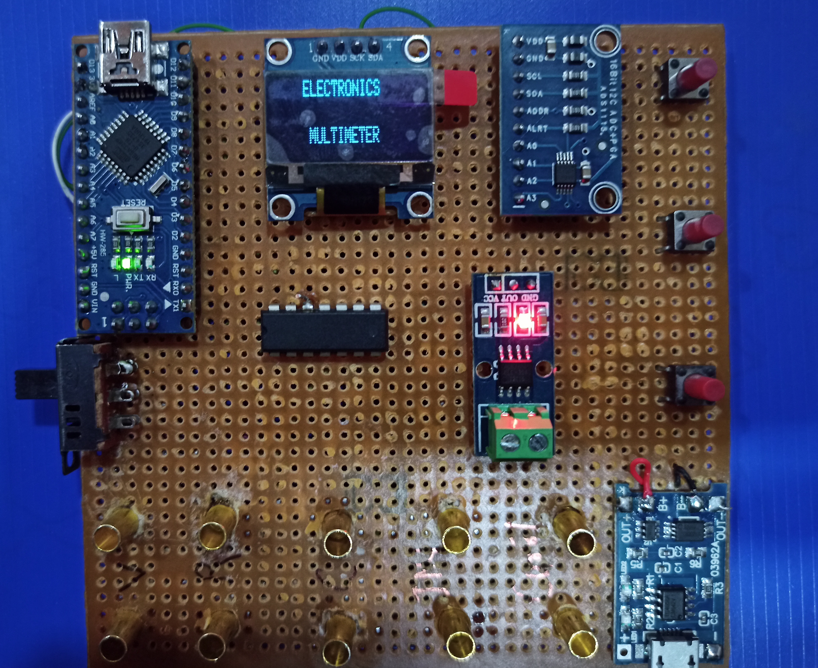
Completed circuit

Slide 14
1. VOLTAGE MEASUREMENT
A microcontroller cannot understand analog voltage directly. That is why we have to use an Analog to Digital Converter or ADC (in our case, ADS1115).
Using ADS1115 ADC converter, the values it will measure will be of high precision.
The circuit should be connected in Voltage divider configuration on the input side in order to measure up to 20V of voltage otherwise the ADS module wil burn out.
Output :

Slide 15
2. RESISTANCE MEASUREMENT
We will use a basic voltage divider to calculate the resistence.
As we know, a voltage divider is made of two resistences (R1 and R2) in series. The output voltage in the middle point is [R2/(R1+R2)]Vin.
Using this formula and knowing the value of one of the two resistors and measuring the Vout it is very easy to calculate the resistence of the seacond resistor.
Output:

Slide 16
3. CAPACITANCE MEASUREMENT
Capacitance is a measure of the ability of "something" to store electrical charge. Arduino capacitance meter relies on the same basic property of capacitors- the time constant.
TC = R x C
TC is the time constant of the capacitor (in seconds).
R is the resistance of the circuit (in Ohms).
C is the capacitance of the capacitor (in Farads).
we charge the capacitor, discharge it and count time. When the capacitor reaches 63.2% of Vcc, we stop the time counter and calculate the capacitance value using the formula.
Output:

Slide 17
4. INDUCTANCE MEASUREMENT
An inductor in parallel with a capacitor is called an LC circuit, and it will electronically "ring" like a bell. Well regardless of the frequency or how hard a bell is struck, it will ring at it’s resonating frequency.
We will electronically strike the LC bell, wait a bit to let things resonate, then take a measurement. (There is some internal resistance so this is really an RLC circuit.)
We count the time between each pulse of the resonancy frequency. If we know the frequency value and also the used capacitance(in this case 2µF), we can get the inductance value and print that to the OLED screen.
Output:

Slide 18
5. Current MEASUREMENT
To measure current, we use the ACS712 module . The ACS712 current sensor is an economical solution for measuring current, it works internally with a Hall effect sensor that detects the magnetic field produced by induction of the current flowing through the line being measured.
The sensor gives us a voltage output proportional to the current, in our case , we used ACS712-05A having range of -5A to 5A and resolution of 0.185 V/A. Next is to use the given formula to compute the current:
I=(SensorVoltage-2.5)/resolution
Output:

Slide 19
advantages
Cost effective
Smaller footprint
Accuracy is more
Easy use because of button architecture
Lower carbon footprint because rechargeable functionality.

Slide 20
ARDUINO CODE:
https://github.com/rohan1110/Arduino_Multimeter
REFERENCES:
[1]Volume-6, Issue-2, March-April 2016 “International Journal of Engineering and Management Research” Page Number: 273-279
“Development of a Digital Multimeter: A Low-Cost Design Approach”
www.circuitbasics.com

